Slide 1
Intuilize – Cluster Commanders Customer Segmentation & Prediction Weekly Meeting 2/7/2025
Andy, Graham, Keertana, & Shashank

Slide 2
Agenda
Plan For Previous Team's Code
Current Segmentation Plan
Further Data Analysis

Slide 3
Previous Team's Code
Prediction model looked good
Going to rework segmentation model

Slide 4
Current Segmentation Plan
Improve on current segmentation by changing number of clusters, using different features, etc.
Achieve a good silhouette score.
Build off prediction model (assuming it still works well with new clustering).

Slide 5
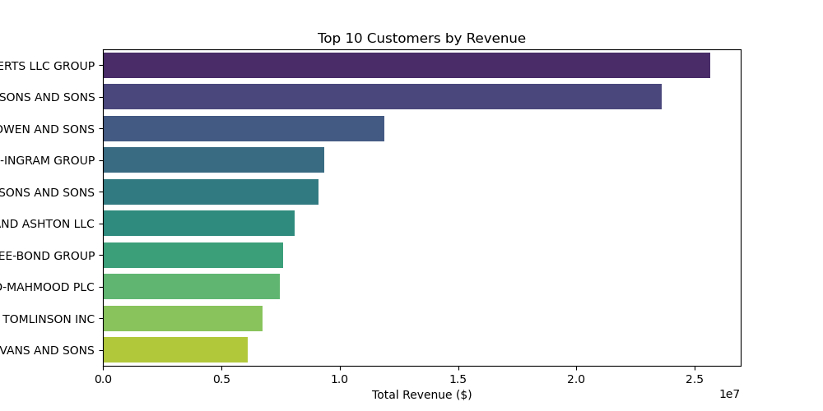
Furthered Data Analysis

Slide 6
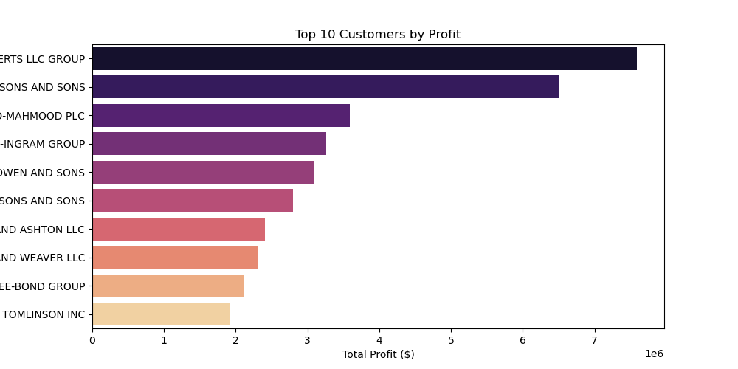

Slide 7
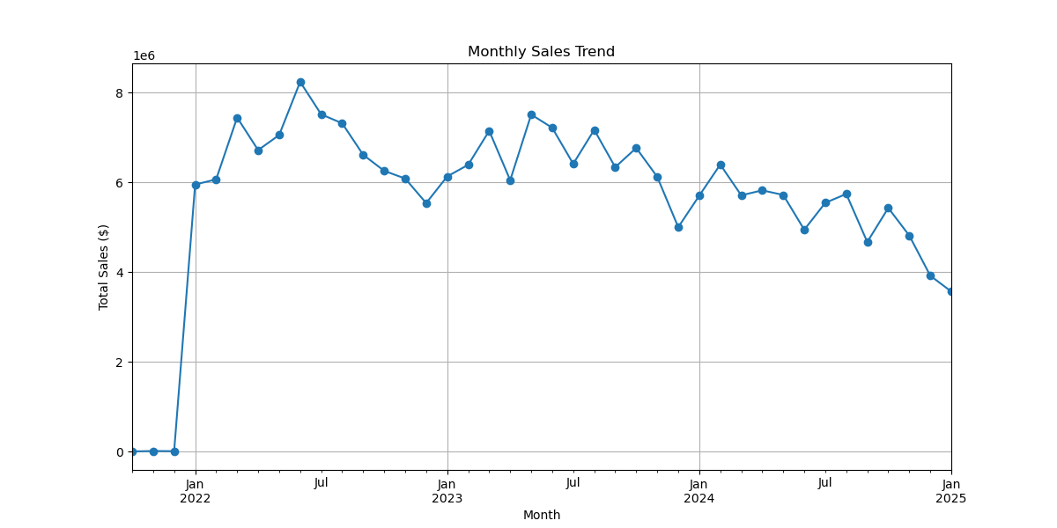

Slide 8
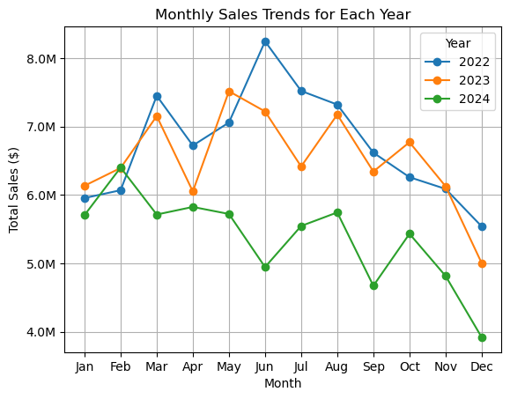

Slide 9
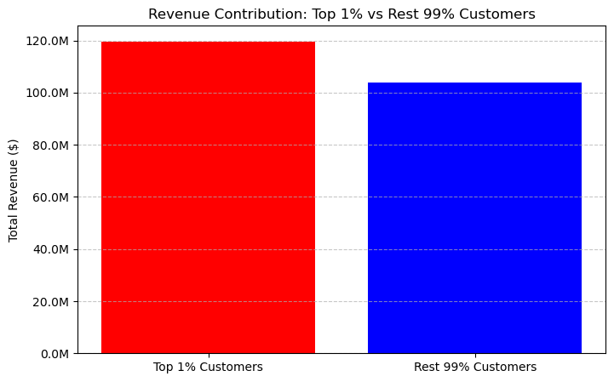
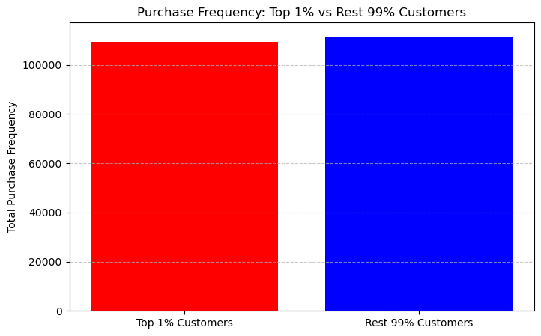
Total Revenue – $223m

Slide 10
THANK YOU!

